Slide 1


Life Simulation
Oğuz Kağan EREN
Alihan BÜYÜKÖZ
Ahmet Talat GEDİKLİ

Slide 2

CONTENT
Description
Weekly Progress
Problems Encountered

Slide 3
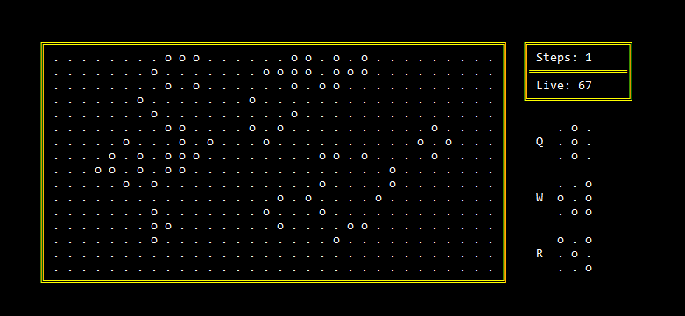
Description of the simulation

Slide 4



Evolution Rules
Birth
Survival
Death by loneliness
Death by overcrowding
3 live neighbours
2 or 3 live neighbours

Slide 5
Special Particles
Particles are placed into simulation area with key Q,W,E,R.
Key 1,2,4 can be used to rotate a specific particle.
 | O
 | O
 | O
 |  | O
O |  | O
 | O | O
Q
W
 | O
 | O
O | O | O
 | O
E
R

Slide 6
Special Particles
Generate ;
New random particle : Key T
New random and place randomly particle: Key Y
Next step : Key SPACE
Cell deletion : Key 3
Clear screen : Key 0

Slide 7
Weekly PROGRESS

Slide 8


How did we do in the first week?
We determined;
what to do ?
how to start ?
what to search ?
what to use ?
we started to;
Learn function and procedures,
Print screen and basic operations.

Slide 9



How did we do in the second week?
We started;
learn more complex contents
figure out some reliable methods
This week also was the week where we individually learnt so much stuff from each other.

Slide 10



How did we do in the third week?
Preparing to presentation
Practicing the seperate lines of ourselves
Using different styles of for, while and function statements.
This was a brain-burning experience for most of us

Slide 11
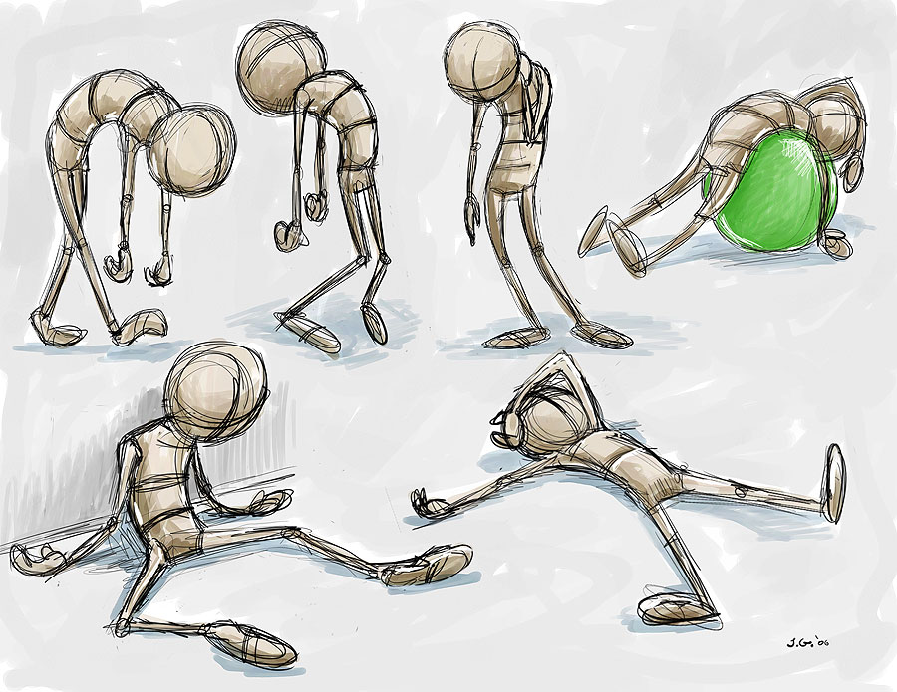
Evaluation
As the project is done, we necessarily evaluated what we have done for the project.
Even though the project is done, we still learn so much when thinking about ‘what more could it contain’.

Slide 12
Problems
ENCOUNTERED

Slide 13
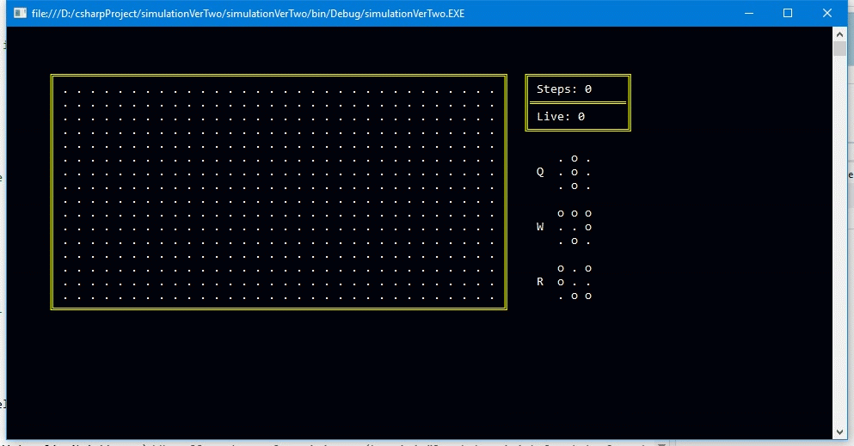
How did we rotate a specific particle?

Slide 14
How did we rotate a specific particle?
matrix
tempMatrix
00 01 02
10 11 12
20 21 22
20 10 00
21 11 01
22 12 02

Slide 15
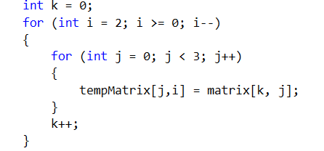
Our Solution
00 01 02
10 11 12
20 21 22
20 10 00
21 11 01
22 12 02

Slide 16
Conclusion
Description of the simulation
Weekly progress
Problems encountered

Slide 17
Thank you for your interest
Any questions?

